Slide 1

华中科技大学
Huazhong University of Science and Technology
Academic integrity
PART 3.1
Shi Yaqian

Slide 2
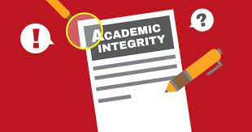
Academic integrity学术诚信
Academic integrity is a fundamental value upon which colleges and universities are built. Students, faculty and staff are expected to contribute candid/fair opinions, reviews and assessments of research and other academic exercises that are vital to sustaining the discussion and exchange of ideas.

Slide 3
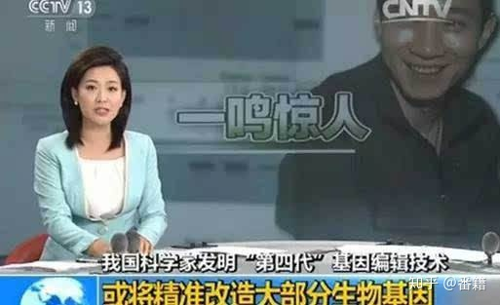
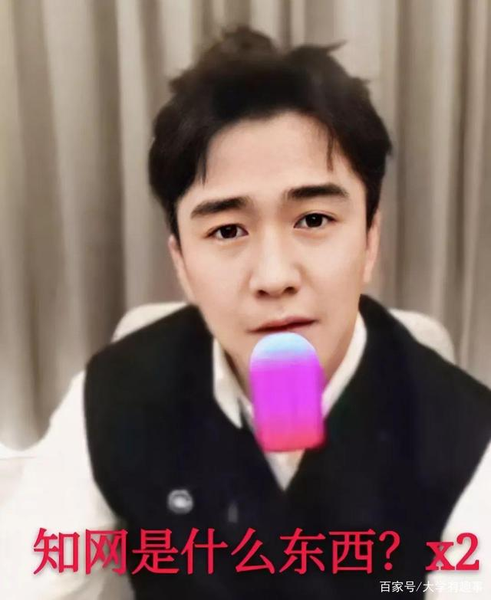
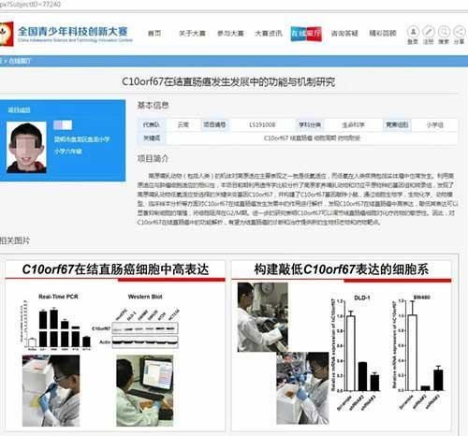
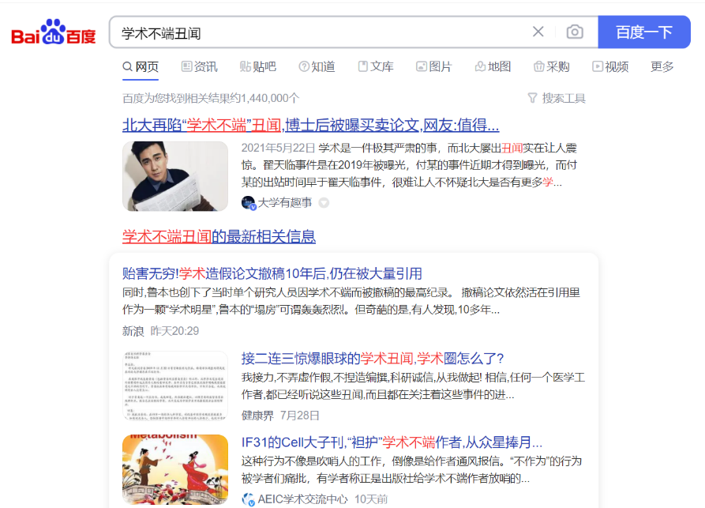
Academic integrity
“知网是什么东西？”
数据造假
小学生写论文：结直肠癌研究获得全国大奖
…….
Notes:
https://zhuanlan.zhihu.com/p/57592248

Slide 4
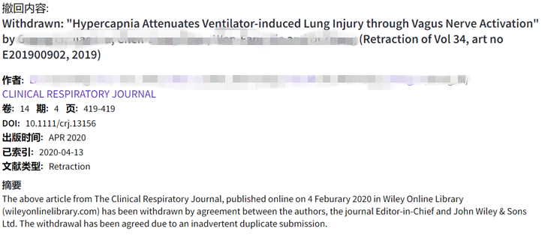
A research on retractions
Lei, L., & Zhang, Y. (2018). Lack of improvement in scientific integrity: An analysis of WoS retractions by Chinese researchers (1997–2016). Science and Engineering Ethics, 24(5), 1409-1420.
Data:
The bibliometric information of 834 retractions from the Web of Science SCI-expanded database by Chinese researchers.

Slide 5
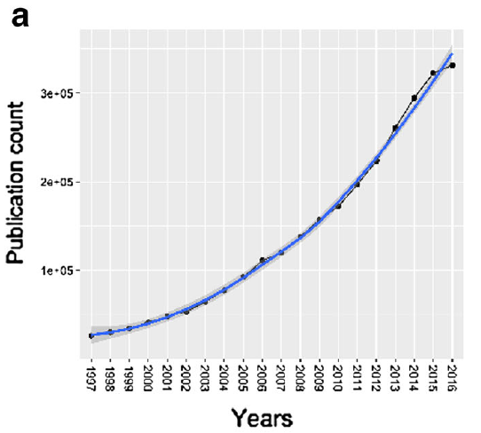
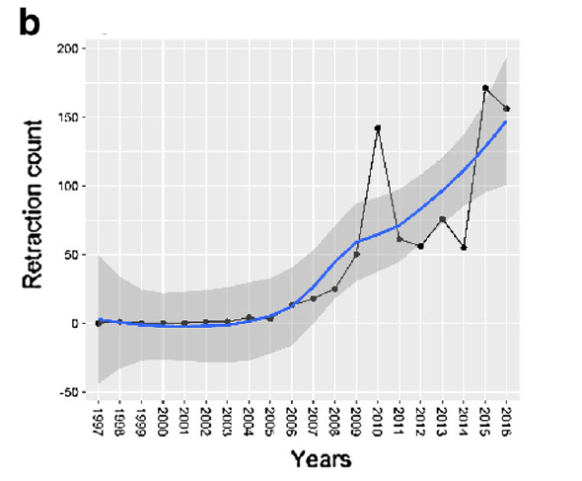
A research on retractions

Slide 6
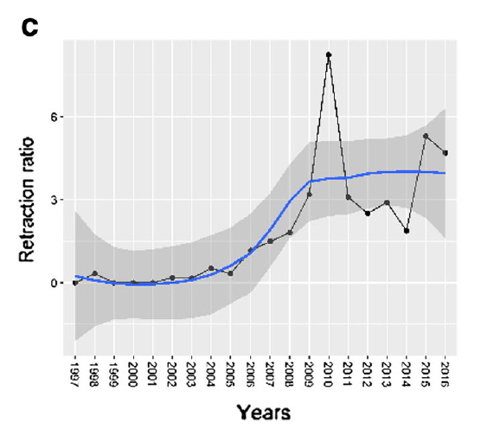
A research on retractions

Slide 7
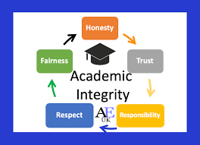
Reasons for retractions
Misconduct
Error
Fraud (fabrication, falsification)
Plagiarism
Faked peer review
Duplicate publication
No permission from institutions/researchers
Honest/administrative error

Slide 8
Fraud (fabrication, falsification)
We are retracting our study because of the continued inability of the research community to replicate the key results in Figure 4, using the protocols provided in our paper. In this figure we report that the Natronobacterium gregoryi Argonaute can efficiently create double-strand breaks and edit the genome of human cells using 5′ phosphorylated single-stranded DNA as a guide. Despite the efforts of many laboratories (Protein Cell 7, 913–915, 2016; Nat. Biotechnol. 35, 17–18, 2017; Cell Res. 26, 1349–1352, 2016; PLOS One 12, e0177444, 2017), an independent replication of these results has not been reported. We are therefore retracting our initial report at this time to maintain the integrity of the scientific record. We nevertheless continue to investigate the reasons for this lack of reproducibility with the aim of providing an optimized protocol.

Slide 9
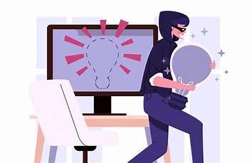
Plagiarism
The above article, published online on 12 December 2020 on Wiley Online Library (wileyonlinelibrary.com), has been retracted by mutual agreement among the authors, the journal co- Editors-in-Chief. The retraction has been issued due to unattributed overlap between this article and the following article published in Thrombosis Research…
The above article, published online on 12 August, 2021, in Wiley Online Library, has been retracted by agreement between the journal Editor in Chief, V.M Balasubramaniam and Wiley Periodicals LLC. The retraction has been agreed due to major overlap with a previously published Chinese-language version of this article from the same group of authors.

Slide 10
Faked peer review
Fake peer review is when an author manipulates the reviewer-recommendation option given by peer-reviewed journals. For this fraudulent activity, authors will submit the name of a real scientist as the recommended reviewer, but they will provide false contact information to route the review request to another person who will give them a positive review, supporting publication of the manuscript. This other person can be the authors themselves, a friend/colleague, or a third-party company that sells fake peer review services for a price. (From Filipodia Publishing LLC)

Slide 11
No permission from institutions/researchers
At the request of the Journal‘s Editor, the Publisher and the authors, the following article has been retracted… The article has been retracted from Journal of International Medical Research because the co-authors of the paper had not consented to the paper's submission for publication, and because the paper does not present the complete findings of the authors' research. The corresponding author, Dr Li, submitted the paper with fraudulent contact details for his co-authors and without their consent to submit.
At the request of the Journal Editor and the Publisher, the following article has been retracted. The article has been retracted after the journal received notice from Sentara Norfolk General Hospital in Norfolk, Virginia (“Sentara”) raising concerns about the accuracy of COVID-19 hospital mortality data reported in the article pertaining to Sentara.

Slide 12
Honest/administrative error
unfortunate mistakes
self-retraction
e.g., The authors wish to retract their paper. The authors have become aware of problems associated with treatment group assignments that have made accurate interpretation of data impossible.

Slide 13
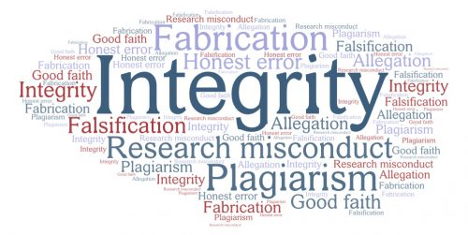
Consequences of misconducts
Withdrawal or retraction of the published papers
Reprimand (惩戒)
Removal from project
Rank and salary reduction
Dismissal
Restitution of funds to the granting agency
Ineligibility to apply for grants for years
…
The end of your research career!

Slide 14
Academic Integrity Quiz
Below are a list of statements about research ethics. You are supposed to read each statement carefully and judge whether it is true or false. You may write a “T” for true and an “F” for false in the bracket following the statement.
You published a paper in a Chinese journal last year. Now, you translate it into an English version and submit to an international journal. This is NOT a breach of academic integrity. ( )
Your dissertation requires at least 100 references. But you only used 90 references. You add 10 more references to your dissertation even though you did not read them. ( )

Slide 15
Academic Integrity Quiz
Below are a list of statements about research ethics. You are supposed to read each statement carefully and judge whether it is true or false. You may write a “T” for true and an “F” for false in the bracket following the statement.
You use the same method as your friend’s to do the experiments and your friend has published his paper, so you just copy the Method section in the his paper. This is NOT a breach of academic integrity. ( )
You intended to explore the doctoral students’ motivation of publication. To this end, you made a survey by questionnaire. You collected 123 questionnaires. However, when you analyzed these questionnaires, you found three of them were undergraduate students, so you eliminated them. This is a breach of academic integrity. ( )

Slide 16
Academic Integrity Quiz
Below are a list of statements about research ethics. You are supposed to read each statement carefully and judge whether it is true or false. You may write a “T” for true and an “F” for false in the bracket following the statement.
You finished an experiment and the results were promising. However, you were too busy to write this paper. Therefore, you asked your classmates to write it and you gave them 1000 RMB. This is NOT a breach of academic integrity. ( )
You finished your first draft of a paper, but there were some grammatical mistakes. Therefore, you invited your friend to polish your language. This is NOT a breach of academic integrity. ( )

Slide 17
华中科技大学
Huazhong University of Science and Technology
Methodology
PART 3.2

Slide 18
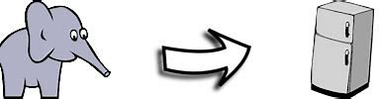
To put an elephant in a fridge
If you’re doing an experiment to examine whether you can put an elephant in a fridge. How will describe the methodology in this experiment?

Slide 19
To put an elephant in a fridge
Elephant: size, weight, age, gender, variety
Fridge: specifications, materials, interior structures…
Tools/Instruments: materials
Process:
Step 1:
Step 2:
Step 3:

Slide 20
Methodology
Please read the methodology sections of the research paper below and answer the following questions.
Article 1: Social Sciences (Print)
Li, C. (2021). A control value theory approach to boredom in English classes among university students in China. The Modern Language Journal, 105 (1), 317-334.
How is it organized? What are the main components/structures?
Identify the key moves or steps the authors take to explain their research methods. For example, do they describe the participants, procedures, materials, and data analysis techniques?
What tense and voice are predominantly used?

Slide 21
Methodology
Recruiting Strategy
Sample
Data Collection Procedure
Instruments
Data Analyses
Questionnaires: Control Appraisal Measure, Value Appraisals Measures, English (as a Foreign Language) Boredom Measure
Semistructured Interview
Quantitative data analysis: descriptive statistics, normality tests, correlation analyses, and regression analyses
Qualitative data analysis: coding, and cross-case comparisons
convenience sampling
Purposeful sampling
2,269 university students
2,002 (88.23%)
58 classes from 11 universities
Semi-structured interviews
Tools: QR code
Questionnaire completion
Invitation to interview
Acknowledgments

Slide 22
Method
Functions
Fundamentals
To specify the methods and procedures conducting the present study
To present data collection and treatment
Theoretical framework or models and research
Experimental apparatus and procedures
Description of materials/data

Slide 23
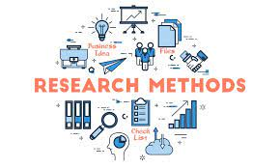
Names of Methods Section
Methods
Methods and Materials
(Proposed) Methodology
Experiment
Method Description and Validation
…
Different names but the same content
In most journals the Methods section follows the Literature Review/Introduction, in others it follows the Conclusions. We choose the former one.

Slide 24

Structures of Method Section
Research questions or hypothesis
Datasets/Data collection
Participants/subjects/samples
Materials
Instruments
Procedures
It may vary depending on requirements of different journals

Slide 25
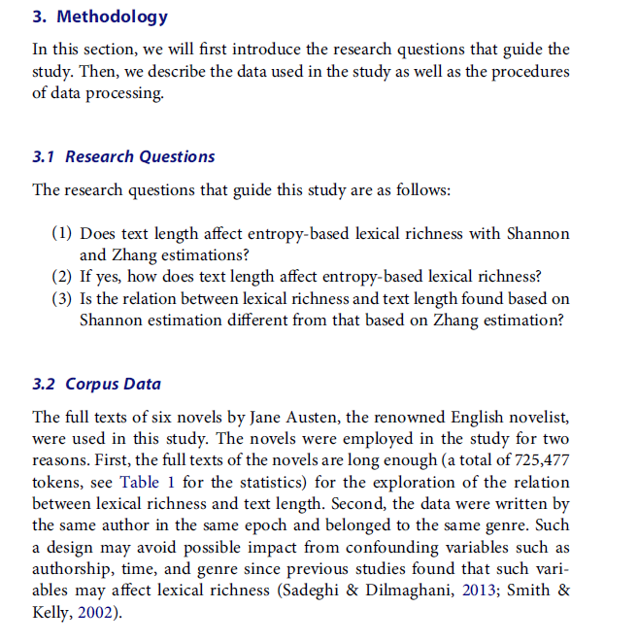
Structures of Method Section

Slide 26

Purposes of the Methods Section
To allow others to replicate what you did
In order to test it
In order to do further research
To allow others to evaluate what you did
To determine whether the conclusions seem valid
To determine whether the findings seem applicable to other situations

Slide 27
Requirements of the Methods section
The description of methods in your study should be as detailed as possible.
Reliability: consistency
Validity: accuracy, measure what you want to measure
Justify every option in the Methods section
1) the group of participants
2) the corpus (size, representative)
3) the tools (reliability and validity of the questionnaires)
4) validity: syntactic parsing, Standford parser 88%
5) the span of time

Slide 28

Requirements of the Methods section
Describe the materials and/or the methods in a complete yet concise way, for example by referring to other works in the literature, including your own, that make use of the same or similar methods.
Write clearly and in a logical order
Do not write more than two steps in one sentence

Slide 29
Method-examples
Materials/data
Quantities
Sources
Details of data collection
Reasons for using such materials/data

Slide 30
Method
Typical sentence structures for describing Materials/data
The data/materials used in this study were …. collected by. The data/materials consisted of …, with a total of more than…words.
The data/materials were used in this study for two reasons. First, … Second, …Therefore, it is particularly appropriate for its use in the present study.
We employed xxx data.
The data of … were selected according to the following criteria

Slide 31
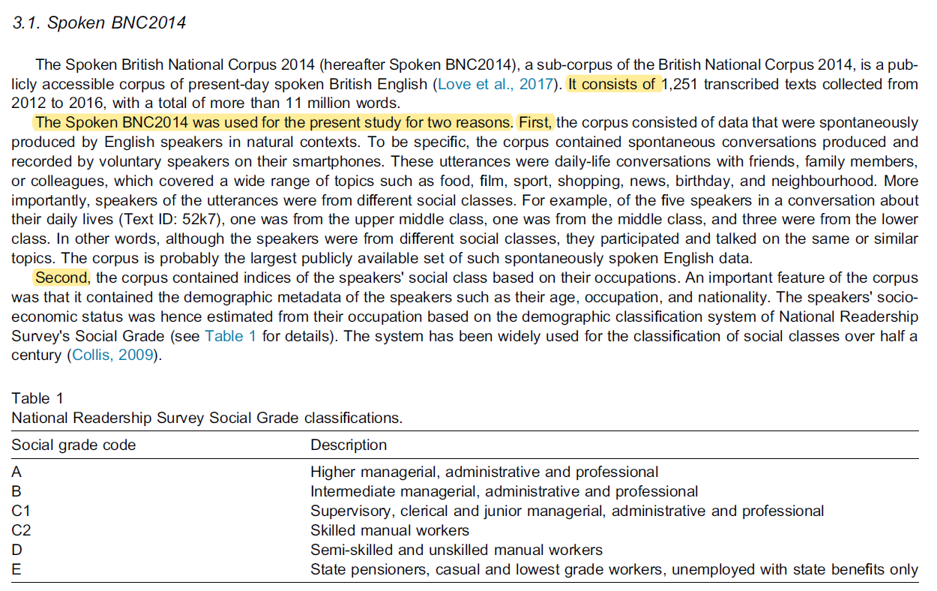
Method

Slide 32
Method
Subject
Human subjects can be commonly used as sources in the field of art and social science.
Special characteristics should be described, such as the subjects’ age, gender, social and cultural background
The standard/criteria of subject selection should be provided.

Slide 33
Method
Typical sentence structure of subject description
A total of … participants (xxx females, xxx males; age range = xxx–xxx years, with a mean of xxx) took part in the study for monetary reward. They were…from…
XXX volunteers were studied (mean age=, mean range=, females=, males= ).
All volunteers gave written informed consent to participate in the study which was approved by…

Slide 34
Method
Examples of subject description
A total of 205 participants took part in the study for monetary reward. They were undergraduate or postgraduate students from South China Normal University and neighboring universities. we excluded the two wubi-method participants, leaving 203 participants (151 females, 52 males; age range = 17–26 years, with a mean of 20.02). All participants reported being right-handed, having normal hearing, and having normal or corrected-tonormal vision (Wang, 2021).
Wang, R., Huang, S., Zhou, Y., & Cai, Z. G. (2020). Chinese character handwriting: A large-scale behavioral study and a database. Behavior Research Methods, 52(1), 82-96.

Slide 35
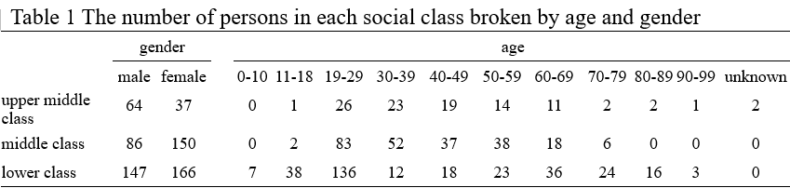
Method
Examples of subject description

Slide 36
Method
Examples of subject description
Eighteen healthy male volunteers (mean age 24 years, range 19–30) were studied. All subjects were free of gastrointestinal symptoms, with no previous gastrointestinal surgery, and were not taking any medications. Subjects were studied after an overnight fast and were not allowed to smoke or drink alcohol for at least 24 hours before the study. All volunteers gave written informed consent to participate in the study which was approved by the medical ethics committee of the Academic Medical Centre, Amsterdam.
Kuiken, S. D., Vergeer, M., Heisterkamp, S. H., Tytgat, G. N. J., & Boeckxstaens, G. E. E. (2002). Role of nitric oxide in gastric motor and sensory functions in healthy subjects. Gut, 51(2), 212-218.

Slide 37
Method
Method/data processing and analysis
It can be presented in a chronological way
The details of data processing and analysis
It is necessary to provide justifications, explanations, and (sometimes) examples

Slide 38
Method
Typical sentence structures of method/data processing and analysis
The experiment was carried out/performed/conducted in …
The apparatus included …
We processed and analyzed the data in the following steps. First, … Second, … Third, …
For illustration purposes, we described below the process of …
We used xxx rather than yyy because …
The reason for using xxx is that it can … and has been found to be effective for…
XXX has been used in many previous studies and proven to be useful

Slide 39
Method
Examples of method/data processing and analysis
The classification task was performed as follows. First, the data were randomly split into the training and testing data. The split ratio between the training and testing data was set at 6:4. Such a ratio has been used in many previous studies and proven to be useful (e.g., Moustafa & Slay, 2016)... Then, the testing data were applied to evaluate the classification performance of the trained model… Last, we conducted feature ranking based on their average weights in the five algorithms (Sun et al., 2013; Zaharie, Lungeanu, & Holban, 2007).

Slide 40
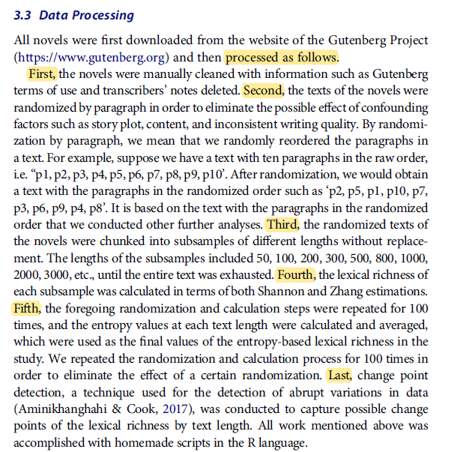
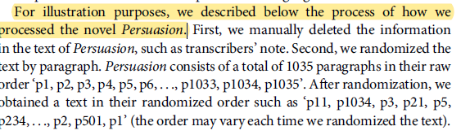
Examples of method/data processing and analysis

Slide 41
Other points to consider
Tenses used
past simple
Voice used
passive voice vs. active voice?
Li Z. (2022). Is academic writing less passivized? Corpus-based evidence from research article abstracts in applied linguistics over the past three decades (1990–2019). Scientometrics,127, pp.5773–5792.

Slide 42
Other points to consider
The passive voice is an essential construction for packaging information. Previous studies observed a trend that academic writing in the late half of the twentieth century witnesses a noticeable decline in the use of the passive voice. Unfortunately, indications of such trend in current academic writing are suggestive and diachronic investigation of passivization in the part-genre of research article abstracts receives little attention. To further attest the trend regarding passivization, this study tracks the evolution of passive uses as well as its relation with active uses initiated by personal pronouns in research article abstracts in applied linguistics. To this end, qualitative and quantitative analysis were conducted on a self-built corpus of 2707 abstracts published in four authoritative applied linguistics journals between 1990 and 2019. The abstracts were grouped into single- and co-authored ones using a self-compiled Visual Basic for Application Excel program and the data were statistically analyzed using SPSS Statistics 17.0. It is found that the occurrence of the passive voice displays an overall declining trend and a significantly negative correlation with the incidence of personal pronoun active uses over the three decades, particularly in co-authored abstracts. Surprisingly, a synchronous dwindle is also detected in the occurrence of personal pronoun active uses in co-authored abstracts, particularly in the latest decade. These findings suggest a shift towards an increasingly informational, efficient and reader-friendly style in abstract writing and give implications to academic writing and English for Academic Purposes instruction.

Slide 43
Further practice
Please search and find a research paper of high quality you are interested in. Analyze the structure, moves, and language features of its methodology section.

Slide 44
Thanks!

